Slide 1

3D Delaunay Triangulation
on GPU
Final Projection - EEC 289Q (Winter 2018)
^{By: Ahmed Mahmoud}
^{Muhammad Awad}

Slide 2
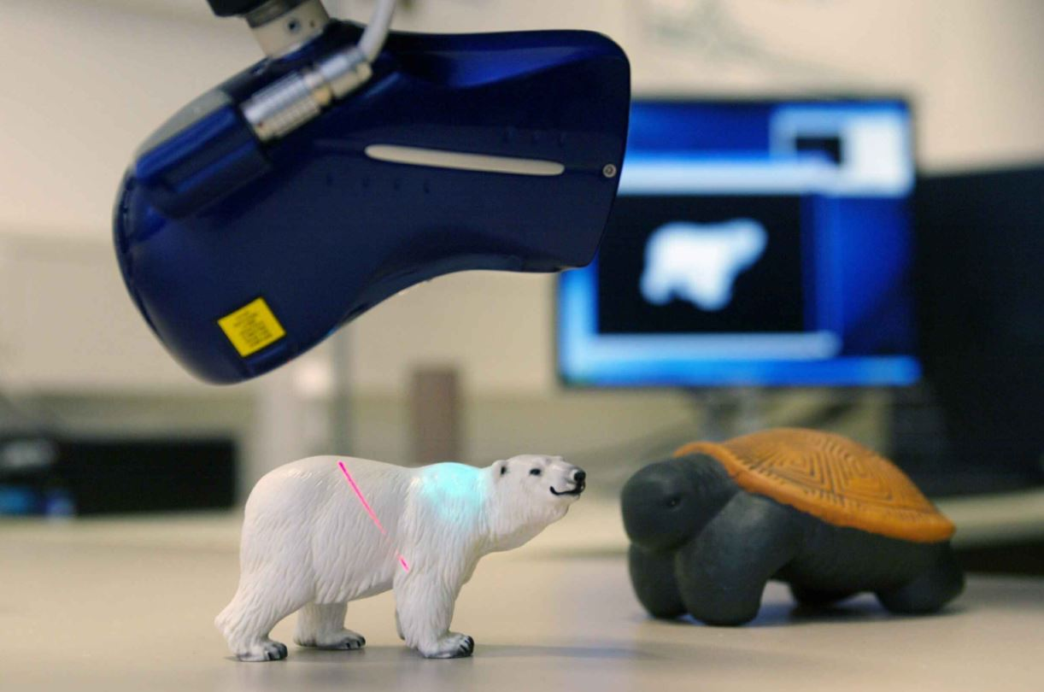
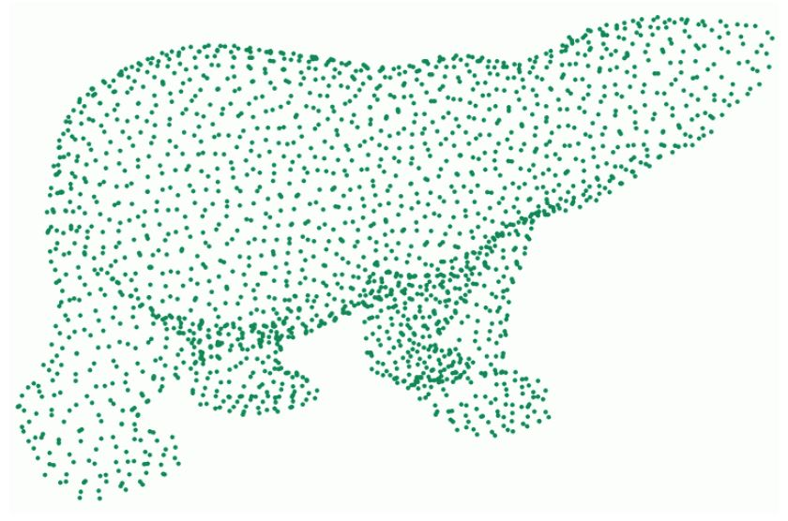
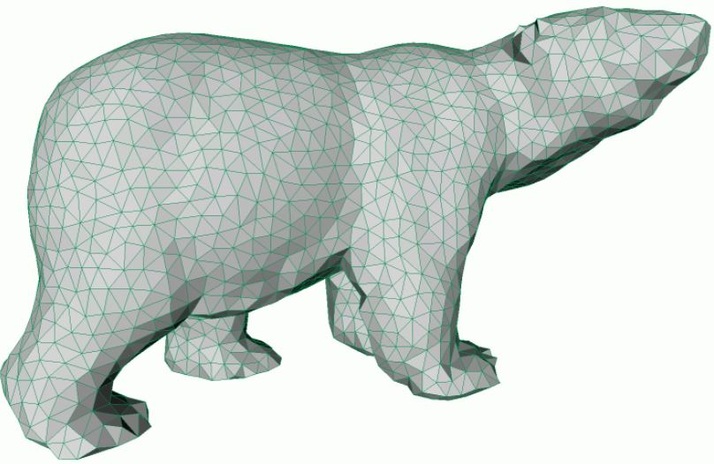
Problem Definition
Scan
Samples
Triangulate
Credits: Geometry Processing - Kai Hormann -2015
Notes:
In floor planning problem, we have some rectangles that are to configured and placed in a such a way that they do not overlap. The objective is usually to minimize the area of the bounding box, which is the smallest rectangle that contains the rectangles to be configured and placed. Each rectangle can be reconfigured, within some limits. For example, we might fix the area of each rectangle, but not the width and height separately (this might give very skinny rectangles so we might also limit the aspect ratio to be within some limits).

Slide 3
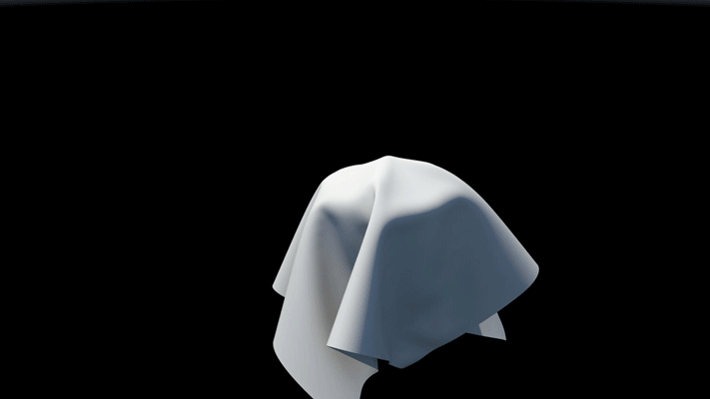
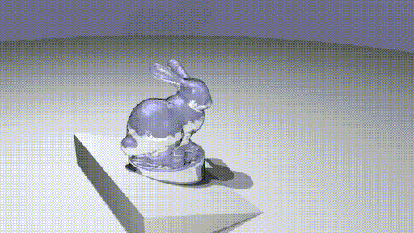
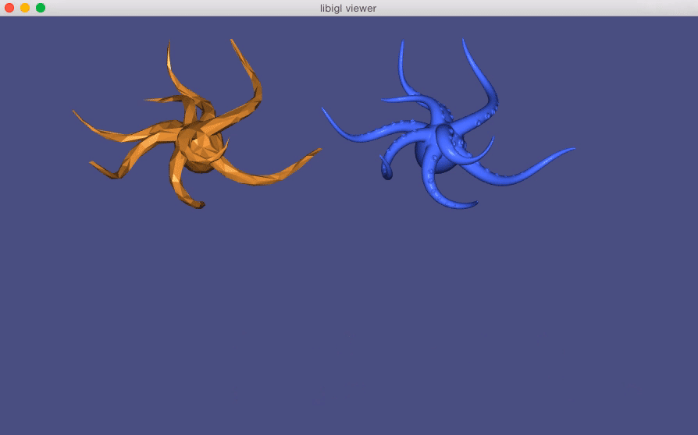
Problem Definition
Cloth Simulation
Fluid Simulation
Shape Deformation
Credits: libigl, Robert Bridson

Slide 4
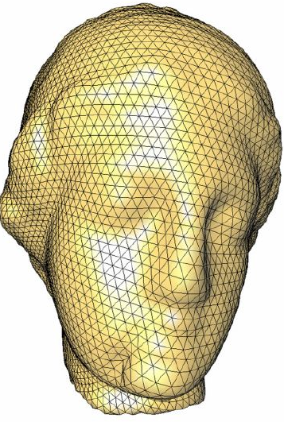
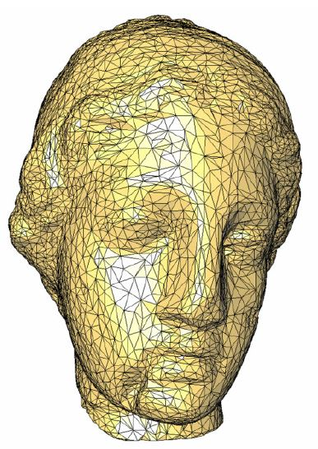

Problem Definition
Physics needs well-shaped triangles
Delaunay gives well-shaped triangles
Credits: Geometric Modeling Based on Polygonal Meshes

Slide 5
Problem Definition
Delaunay = Empty circumcircles
Circumcircles
2D
Samples

Slide 6
Problem Definition
Delaunay = Empty circumcircles
3D
Circumsphere
Tetrahedron
Samples

Slide 7
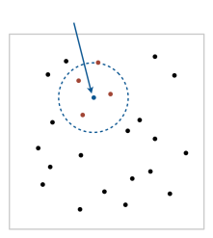
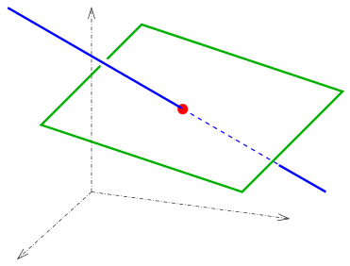
Approach
Building Blocks:
- Range search
- Simple plane-line trimming
Sample
range
3D plane
line

Slide 8
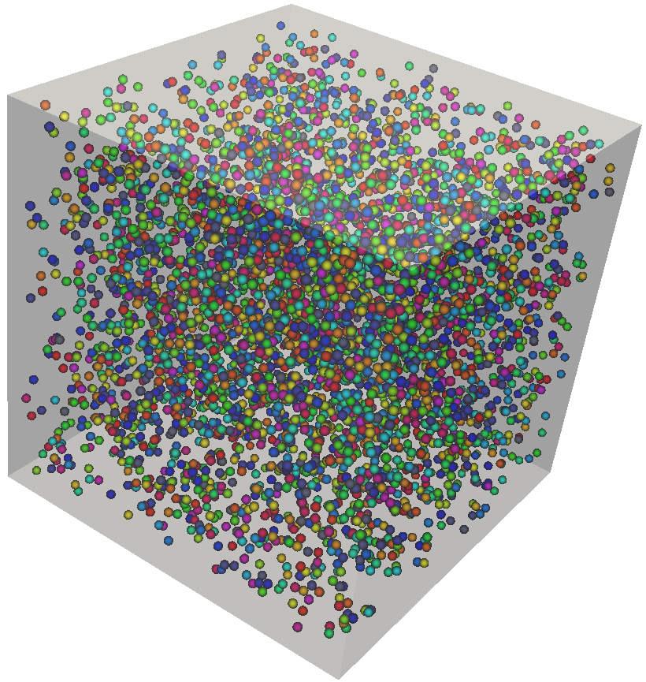
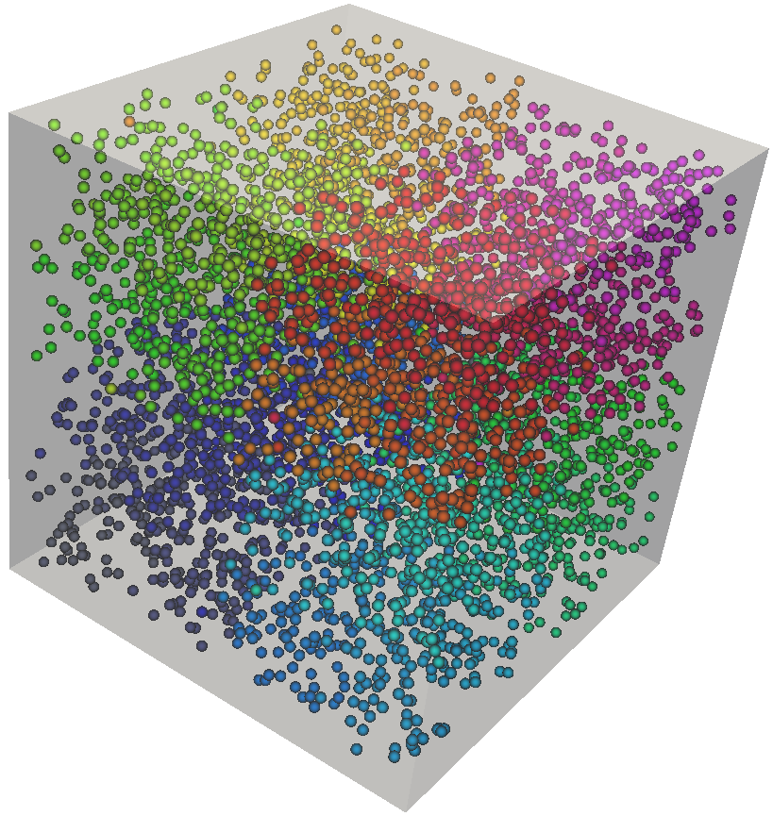
Optimization Choice: Memory Layout
Challenges
Input
Strongly Balanced k-d Tree
Output (Kernel Input)

Slide 9

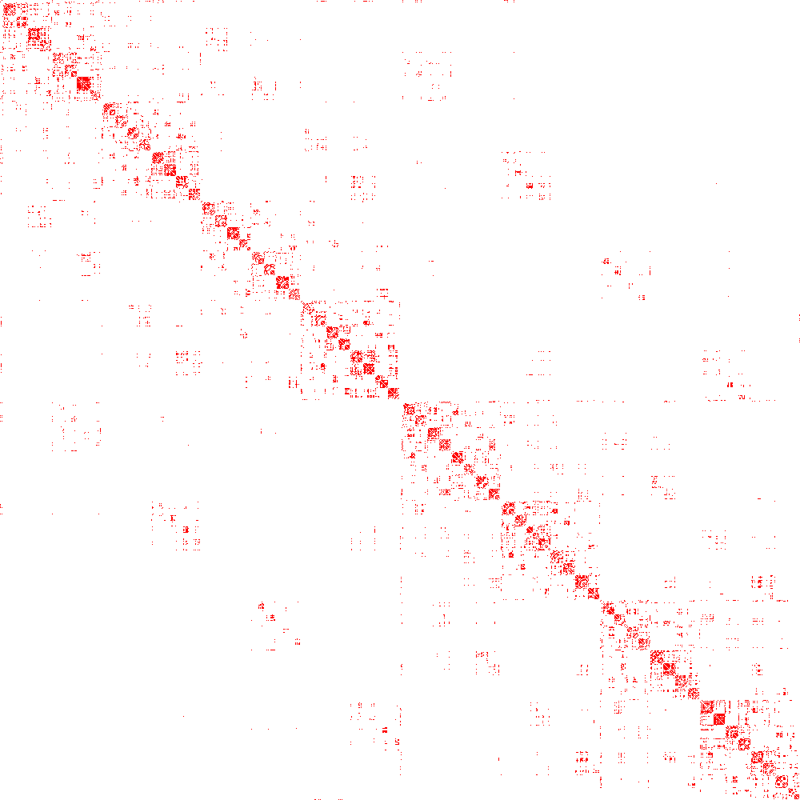
Optimization Choice: Memory Layout
Challenges
Input
Output (Kernel Input)
Strongly Balanced k-d Tree
Adjacency Matrices

Slide 10
Optimization Choice: Memory Layout
Challenges
Input
Output (Kernel Input)
Strongly Balanced k-d Tree
Adjacency Matrices

Slide 11

Optimization Choice: Memory Layout
Challenges
Kernel Input
Strongly Balanced k-d Tree
Output
Delaunay Connectivity
Output
Adjacency Matrices

Slide 12
Optimization Choice: Memory Layout
Challenges
Kernel Input
Strongly Balanced k-d Tree
Output
Delaunay Connectivity
Output
Adjacency Matrices

Slide 13
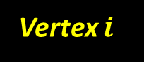
Challenges
Required Work per One Vertex
Number of neighbors is different for each vertex
Filtered
Vertex $i$
Kernel Input
Strongly Balanced k-d Tree
Output
Delaunay Connectivity
Output
Adjacency Matrices

Slide 14
Thank You!

Slide 15
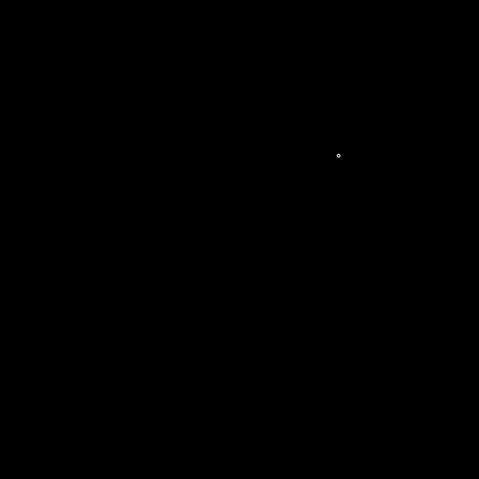
Extra Slides
Bowyer-Watson algorithm
Credits: https://imgur.com/gallery/fDRorkf

Slide 16
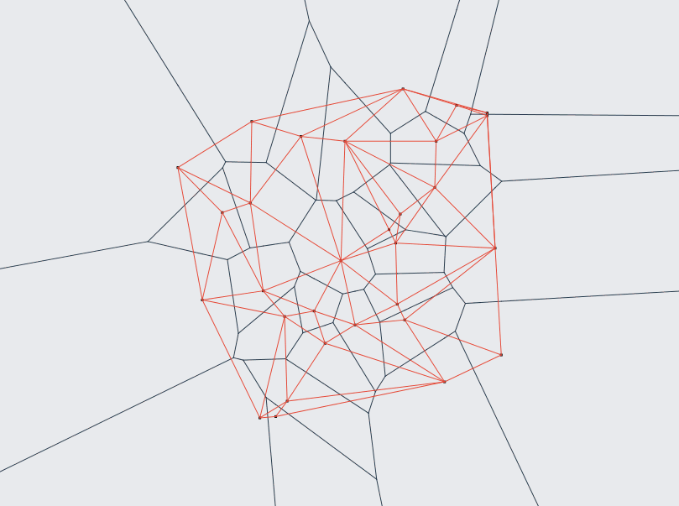
Extra Slides
Bowyer-Watson algorithm
Credits: https://github.com/miyu/voronoi

